Slide 1



SC1015 Mini project
Done by:
Ng Xuan Yi [U2121532G]
Fong Ye Xuan [U2120767B]
Arjun Kumar Nair [U2122598K]

Slide 2


Practical Motivation
Real-Life Problem Encountered:
The Great Resignation is an ongoing economic trend in which employees have voluntarily resigned from their jobs en masse, beginning in early 2021, primarily in the United States.
Possible Causes include:
Wage Stagnation
Long Lasting Job Dissatisfaction, et cetera.

Slide 3



Dataset – IBM HR Employee Attrition
Dataset Taken from Kaggle:
https://www.kaggle.com/datasets/pavansubhasht/ibm-hr-analytics-attrition-dataset
Dataset shows the factors that lead to employee attrition
1470 rows
35 columns

Slide 4



Problem Statements
1. Which combination of factors are the most significant causes for employee attrition?
2. How can employee attrition be predicted?

Slide 5






Data Cleaning and Preparation I
General Cleaning of Data:
Removal of any Null or Duplicated Values
Formatting of Variables
Capitalising and
Removal of Whitespace

Slide 6


Data Cleaning and Preparation II
Specific Cleaning of Data:
Binary Variables
Using One-Hot Encoding, we translated the binary variables like Attrition [Yes/No] into numeric values, so that we can process them.
Categorical Variables
We are unable to make use of the same methodology for Categorical Variables like Department because they have more than TWO categories.
Hence, we used Label Encoding from the SckitLearn Pre-Processing Library to translate them into numeric values.

Slide 7

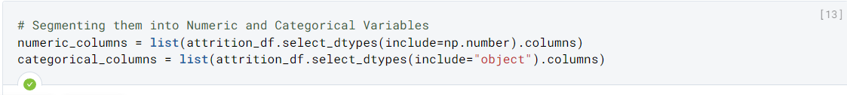
Data Cleaning and Preparation III
Segmentation of Numeric and Categorical Variables:
Finally, we separated the variables into two lists, which contains the numeric and categorical variables respectively.
Figure 1 Screenshot from our Project

Slide 8
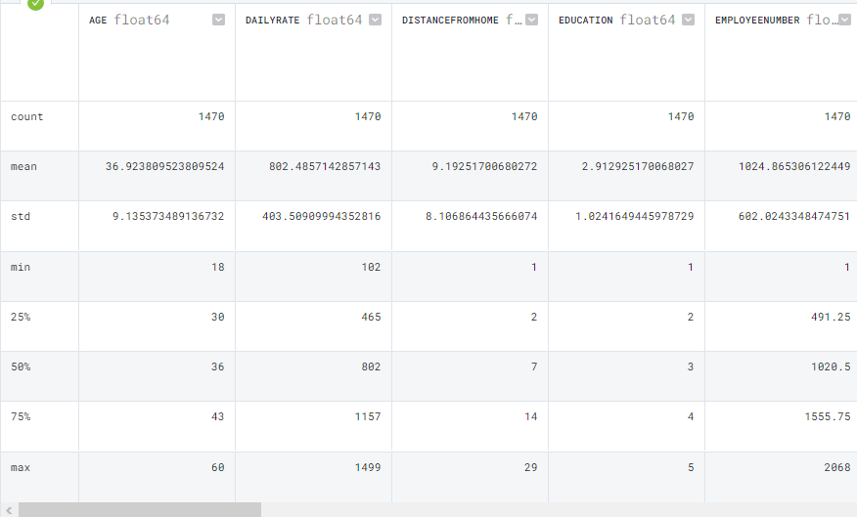

Figure 2 Screenshot of various metrics from our Project

Slide 9




Statistical Analysis - Insights
Based on the values of the Mean:
As a general rule, as the age of the employees goes up, their monthly renumeration also rises.
Most employees are middle-aged, at 35.
Almost no employees are still working at IBM after 60.

Slide 10




Basic Exploratory Data Analysis
In order to further refine our thoughts and identify more detailed trends, we decided to perform EDA by using:
Boxplots,
Histograms, and
Violin-plots.

Slide 11

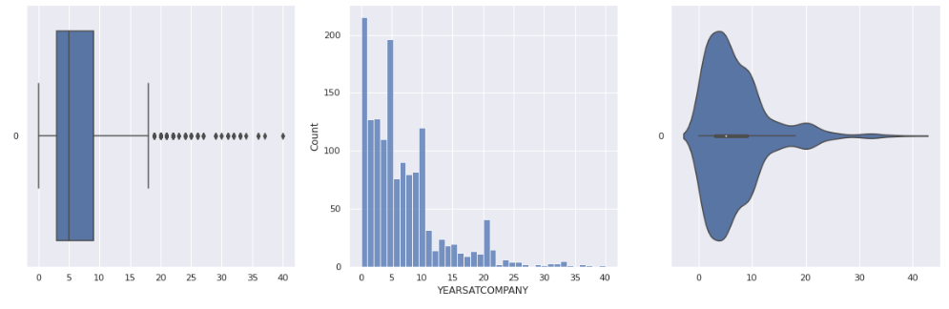
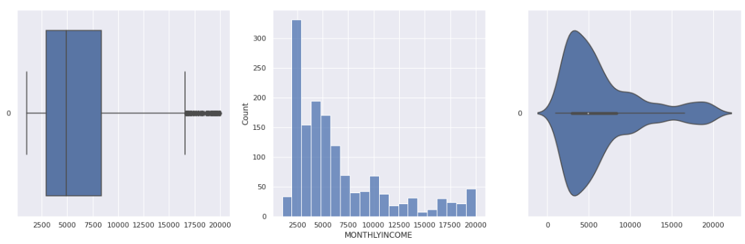
Basic Exploratory Data Analysis - Insights
Findings:
Huge number of outliers in variables that are related to the number of years employees were at the company.
This can potentially affect our machine learning models.
Therefore, we removed them before commencing Machine Learning

Slide 12

Machine Learning
Logistic Regression
Decision Tree
Multilayer Perceptron Neural Network (MLP)

Slide 13
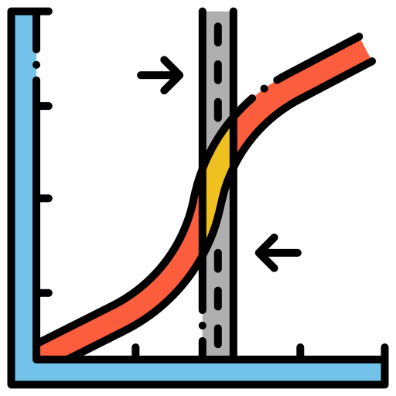
Machine Learning model: Logistic Regression
Our dependent variable ('Attrition') has a binary outcome
Logistic Regression models a binary outcome, suitable for our dataset (relatively better than linear regression)
Numeric data are used for this model as independent variable to predict 'Attrition', our dependent variable

Slide 14
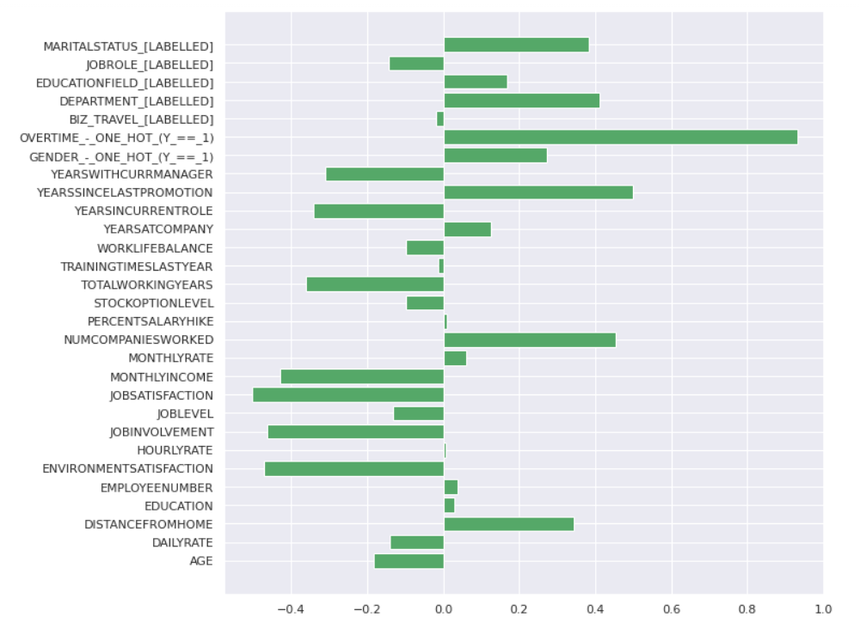

Application Logistic Regression
Used a built-in method to obtain the coefficients of every variable
This is to determine variable importance

Slide 15
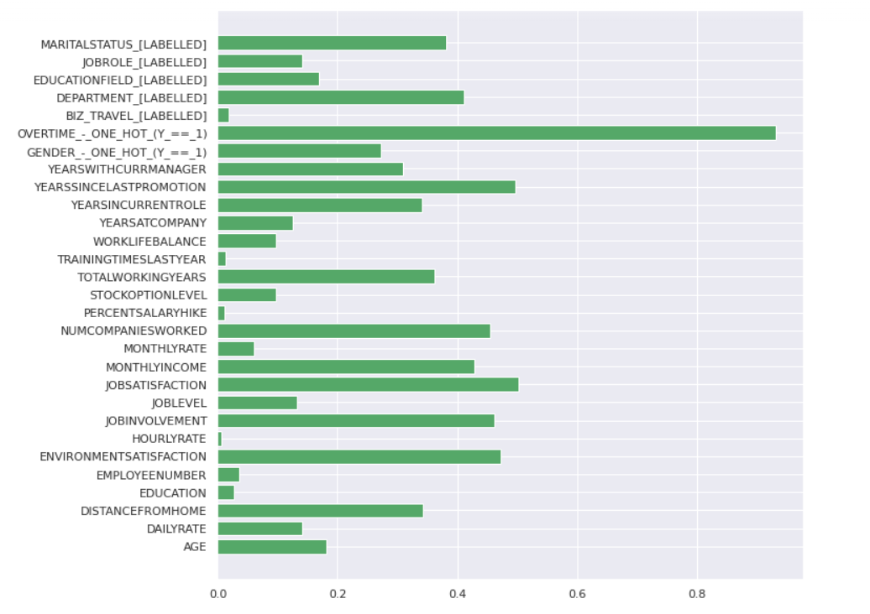
Application Logistic Regression
This bar chart shows the absolute value of every variable's importance
Easier visualisation in determining the more important variables

Slide 16
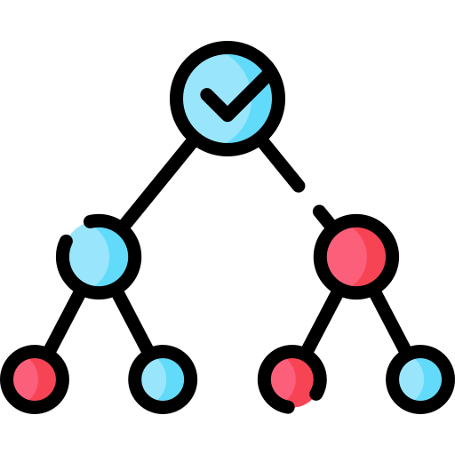
Machine Learning model: Decision Tree
Definition: Non-parametric supervised learning model that is used for classification and regression.
Curbing overfitting and underfitting of data:
Shortlisted 8 variables according to feature importance from Logistic Regression
Limited depth to 2 and 4
Split data into train and test in 80:20 ratio

Slide 17
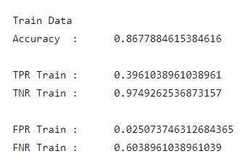
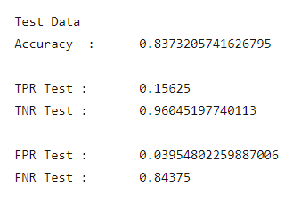
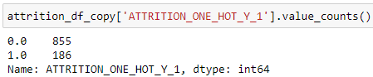
Decision Trees
Conclusion: Though classification accuracy is decent, there is still room for improvement as there is very low TPR due to high class imbalance.

Slide 18
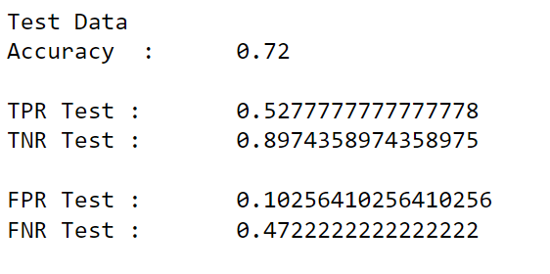
Solution- Resampling of data
Good:
No more class imbalance
Hence, decision tree results are more reliable
Bad:
Classification accuracy metrics are generally lower

Slide 19
Insights and Possible Improvements
Insights (just to take note of):
OVERTIME_ONE_HOT_Y_1 = 0
MONTHLY INCOME < 2563
NUMCOMPANIESWORKED < 5.5
ENVIRONMENT SATISFACTION < 3.5
OVERTIME_ONE_HOT_Y_1 < 0.5
MONTHLY INCOME > 2064
ENVIRONMENT SATISFACTION < 1.5
JOB SATISFACTION < 1.5
ATTRITION = 0
ATTRITION = 1
Possible Improvements:
Cross Validation of Decision Tree, Random Forest, Multilayer Perceptron Neural Network

Slide 20

Multilayer Perceptron Neural Network [MLP]
To deal with our second half of our Problem Statement, we decided to make use of our the MLP Neural Network.
Rationale for using MLP:
No mathematical model available can fully represent or model our relationship.
Generally, MLPs are suitable for:
Tabular datasets
Classification Prediction Problems
Regression Prediction Problems
They are also very flexible and can be used generally to learn a mapping from inputs to outputs.

Slide 21
Multilayer Perceptron Neural Network [MLP]
Definitions:
A multilayer perceptron (MLP) is a fully connected class of feedforward artificial neural network (ANN).
An MLP consists of at least three layers of nodes: an input layer, a hidden layer and an output layer.

Slide 22
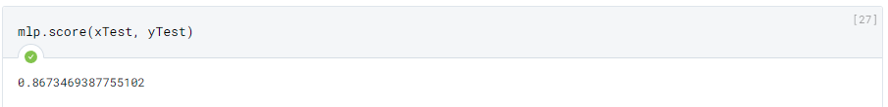
Application of MLP Neural Network
Using our encoded attrition variable as our Y and the rest of our numeric variables as X, we split the dataset into a Training and Test datasets in a 8:2 split.
Using the Training Dataset, we trained the MLP Model using .fit().
Using mlp.predict, we calculated the expected values of Y by making use of the test values of X.
Finally, to determine the accuracy of our model, we made use of mlp.score:

Slide 23
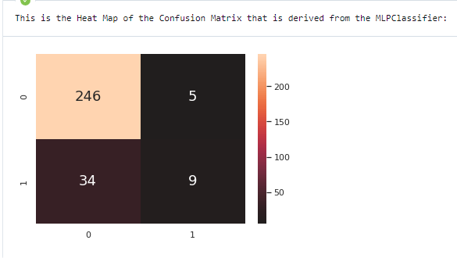
Application of MLP Neural Network
For ease of digestion, we made a heatmap of the Confusion Matrix of our Classification, as shown.
Hence, our MLP model could correctly predict the employees who are unlikely to quit and chose to not quit. [True Negatives]
TNR = [246 / (246+5)] * 100% = 98.0%
Unfortunately, they failed to predict the employees who are supposed to quit, but chose not to quit. [True Positives] As the TP Rate is:
TPR = [9 / (34+9)] * 100% = 20.9%

Slide 24



Insights of MLP Neural Network
After deliberation, we realised that the results makes sense. This is because:
Before the Great Resignation, employees were very unwilling to quit their jobs even in very poor conditions.
This maybe because of financial responsibilities, familial situations, and societal pressure et cetera. Which are all factors not included in our dataset.
Even if they are included, the complex nature of every individual’s situation makes it almost impossible to work with.
Financial Woes
Family Issues
Societal Issues

Slide 25




Implications
Therefore, there are almost no models available now to be able to determine the reasons for a person to quit perfectly.
Instead, we are only able to determine factors that makes it likely for someone to quit. Once identified, we should work towards making it less likely for them to quit, for the good of society.

Slide 26




Conclusion
Problem statement Part 1:
Using Logistic Regression and Decision Trees, factors that played a significant role in causing employee attrition were identified.
Problem statement Part 2:
We modelled predictors for Employee Attrition using MLP.
Uses of our Mini Project:
Employers can utilise this information to detect the possibility of an employee quitting early.
Human Resource Departments are aware of how to build workspaces to minimise employee attrition.

Slide 27


